Slide 1
GROUP PROJECT IN CLOUD COMPUTING CSC8109 DESIGN AND IMPLEMENTATION OF A FAIR EXCHANGE SERVICE.
Team
Stephen Shephard
Mahfuz Ali
Huan Xu
Yue Yuan
Zayyad Gaya

Slide 2
PROJECT SPECIFICATION
Coffey-Saidha fair exchange protocol
Java Programming Language
Amazon S3 for Storage Service
Amazon Dynamo for Database (NoSQL)
Simple Queuing Services for Messaging Service
Java Cryptography Libraries

Slide 3
PROTOCOL
Notations:
L: Unique label to link all message of a given protocol run
EOO: SigA(H(doc))
EOR: SigB(sigA(H(doc)))

Slide 4
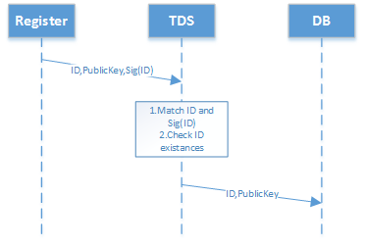
PROTOCOL CONTI….
Step0: Alice and Bob register;

Slide 5
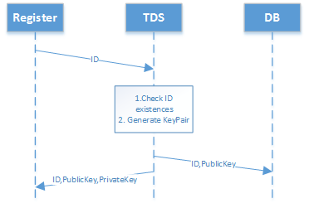
PROTOCOL CONTI….

Slide 6
PROTOCOL CONTI….
Step1: Alice sends a request to TTP that she wants a fair exchange with Bob;
Step2: TTP sends a unique label to Alice;
Step3: After Alice receives the label, she will send the document which she wants to give Bob and EOO(SigA(H(doc))) and label to TTP, After TTP receives the message from Alice, it stores the document;

Slide 7
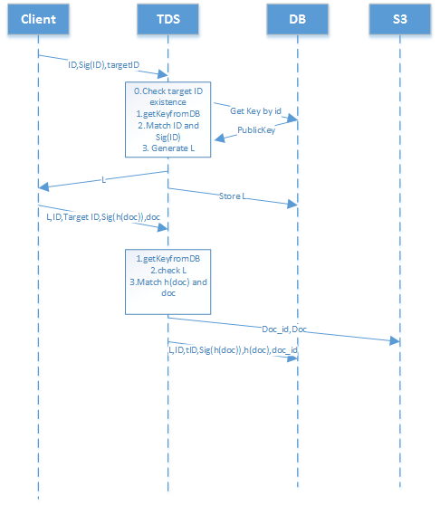
PROTOCOL CONTI….

Slide 8
PROTOCOL CONTI….
Step4: TTP sends the EOO(SigA(H(doc))) and the label to Bob.
Step5: Bob sends the EOR(SigB(SigA(H(doc)))) and label to TTP after he receives EOO.
Step6: After receiving EOR from Bob, TTP would send the document and label to B which it store before.
Step7: TTP sends EOR and label to Alice which means Bob will receive the document which Alice wants to give.
Step8: Alice and Bob send the label to TTP which means this fair exchange finished.

Slide 9
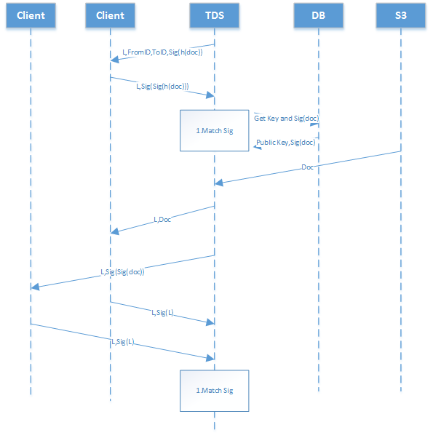
PROTOCOL CONTI….

Slide 10
ABORT PROTOCOL
Step1: Alice sends SigA(abort, MxA).
Step2:TTP sends Alice, resolved? If true then send resolved contract and if false, send abort token, set aborted=true;

